Slide 1
Entity Framework core

Slide 2
What is entity framework ?
Entity Framework was first released in 2008, Microsoft's primary means of interacting between .NET applications and relational databases. Entity Framework is an Object Relational Mapper (ORM) which is a type of tool that simplifies mapping between objects in your software to the tables and columns of a relational database.
Entity Framework (EF) is an open source ORM framework for ADO.NET which is a part of .NET Framework.
An ORM takes care of creating database connections and executing commands, as well as taking query results and automatically materializing those results as your application objects.
An ORM also helps to keep track of changes to those objects, and when instructed, it will also persist those changes back to the database for you.

Slide 3
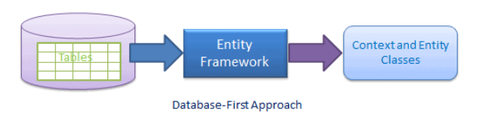
Using database first approach
It creates model codes (classes, properties, DbContext etc.) from the database in the project and those classes become the link between the database and controller.
The Database First Approach creates the entity framework from an existing database. We use all other functionalities, such as the model/database sync and the code generation, in the same way we used them in the Model First approach.

Slide 4
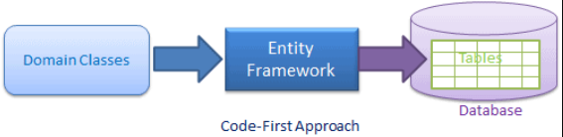
Using code-first approach
Use this approach when you do not have an existing database for your application. In the code-first approach, you start writing your entities (domain classes) and context class first and then create the database from these classes using migration commands.
Developers who follow the Domain-Driven Design (DDD) principles, prefer to begin with coding their domain classes first and then generate the database required to persist their data.

Slide 5
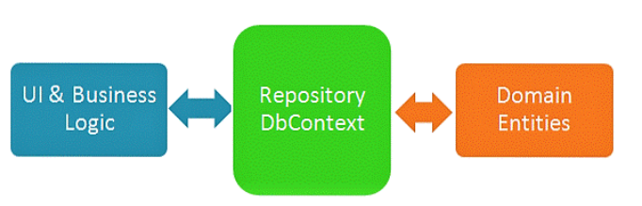
Implementing repository pattern
The repository pattern is intended to create an abstraction layer between the data access layer and the business logic layer of an application. It is a data access pattern that prompts a more loosely coupled approach to data access. We create the data access logic in a separate class, or set of classes, called a repository with the responsibility of persisting the application's business model.

Slide 6
ADVANTAGES OF Repository pattern
The repository pattern has some advantages which are as follows.
As we can access data source from many locations, so we can apply centrally managed, caching, consistent access rules and logic
As business logic and database access logic are separate, so both can be tested separately.
It provides the code's maintainability and readability by separating business logic from the data or service access logic.
Provides a flexible Architecture

Slide 7
Sql query logging
Entity Framework Core integrates with the .NET Core logging to log SQL and change tracking information to the various output targets.
Installation :

Slide 8
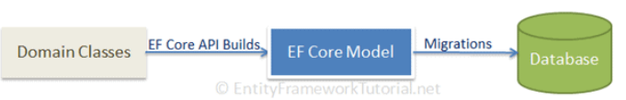
Migration and database update
Migration is a way to keep the database schema in sync with the EF Core model by preserving data.
As per the above figure, EF Core API builds the EF Core model from the domain (entity) classes and EF Core migrations will create or update the database schema based on the EF Core model. Whenever you change the domain classes, you need to run migration to keep the database schema up to date.

Slide 9
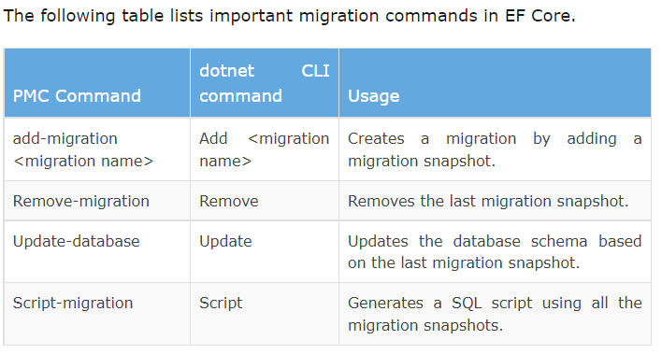

Slide 10
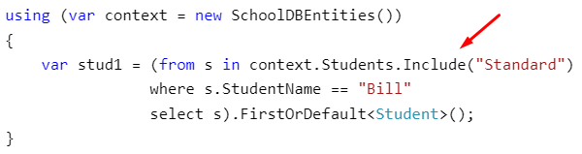
Eager loading
Eager Loading helps you to load all your needed entities at once; i.e., all your child entities will be loaded at single database call.
Eager loading is the process whereby a query for one type of entity also loads related entities as part of the query,
Eager loading is achieved using the Include() method.

Slide 11

Lazy loading
Lazy loading is delaying the loading of related data, until you specifically request for it. It is the opposite of Eager loading.
Rules :
context.Configuration.ProxyCreationEnabled should be true.
context.Configuration.LazyLoadingEnabled should be true.
Navigation property should be defined as public, virtual. Context will NOT do lazy loading if the property is not defined as virtual.

Slide 12

Explicit loading
There are options to disable Lazy Loading in an Entity Framework. After turning Lazy Loading off, you can still load the entities by explicitly calling the Load method for the related entities. There are two ways to use Load method Reference (to load single navigation property) and Collection (to load collections)

